Slide 1
Governing Equation
Fluid motion is totally defined by the conservation of the mass , momentum and energy.
Other quantities, such as pressure, temperature, entropy, do not satisfy a conservation law.
It means that equation for those quantities will not be in the form of a conservation law.

Slide 2

Conservation of Mass
Integral Form
We consider fluids in arbitrary system which have material volume $𝒱_{sys}$.
Using Reynolds Transport Theorem with proper control volume $CV$, conservation of mass can be expressed as follow
$$\frac{dm}{dt}=0$$
$$⇒\frac{d}{dt}\int_{𝒱_{sys}}{ρ\left(x,t\right)dV}=0$$
$$⇒\frac{∂}{∂t}\int_{CV}{ρ}d𝒱+\int_{CS}{\left(ρu\right)⋅n}d𝒜=0$$
$$⇒\frac{∂}{∂t}\int_{CV}{ρ}d𝒱+\int_{CS}{ρV}d𝒜=0 ,V=u⋅n$$
Differential Form
if $ρu$ is differentiable, we can use divergence theorem
$$\int_{CV}{\left\{\frac{∂ρ}{∂t}+div\left(ρu\right)\right\}}d𝒱=0$$
The above relation holds for any volume, which can be possible only if the integrand going to 0 at every points.
$$\frac{∂ρ}{∂t}+div\left(ρu\right)=0$$

Slide 3

Conservation of Momentum
Integral Form
We consider fluids in arbitrary system which have volume $V_{sys}$.
Let $F$ is force vector and it is consist of body force $F_{b}$ and surface force $F_{s}$.
From Newton’s second law
$$\frac{d}{dt}\left(mu\right)=F$$
$$⇒\frac{d}{dt}\int_{V_{sys}}{ρu}dV=F_{b}+F_{s}$$
Using Reynolds Transport Theorem with proper control volume $CV$
$$\frac{∂}{∂t}\int_{CV}{ρu}d𝒱+\int_{CS}{ρu⊗u⋅n}d𝒜=\int_{CV}{ρfdV}+\int_{CS}{τ⋅n}d𝒜$$
$$⇒\frac{∂}{∂t}\int_{CV}{ρu}d𝒱+\int_{CS}{ρuV}d𝒜=\int_{CV}{ρfdV}+\int_{CS}{τ⋅n}d𝒜, V=u⋅n$$

Slide 4

Conservation of Momentum
Differential form
If every integrand in surface integral is differentiable, by divergence theorem
$$\int_{CV}{\left[\frac{∂}{∂t}\left(ρu\right)+div\left(ρu⊗u\right)−ρf−div\left(τ\right)\right]}d𝒱=0$$
The above relation holds for any volume, which can be possible only if the integrand going to 0 at every points.
Thus differential form of conservation of momentum is
$$\frac{∂}{∂t}\left(ρu\right)+div\left(ρu⊗u\right)−ρf−div\left(τ\right)=0$$
In a little more detail, $τ$ is defined by constitutive equation for Newtonian fluids (Appendix 2) and it can be simplify with stokes’ assumption
$$τ=−\left[p+\frac{2}{3}μ div\left(u\right)\right]I+μ\left(grad\left(u\right)+{\left[grad\left(u\right)\right]}^{T}\right)$$

Slide 5

Conservation of Momentum
The above relation holds for any volume, which can be possible only if the integrand going to 0 at every points.
$$\frac{∂ρu}{∂t}+div\left(ρuu\right)=ρf+div\left(τ\right)$$
$$\frac{∂ρu}{∂t}+\left(ρu⊗u\right)⋅∇=ρf+τ⋅∇$$
$$\frac{∂}{∂t}\left(ρu_{i}\right)+\frac{∂}{∂x_{j}}\left(ρu_{i}u_{j}\right)=ρf_{i}+\frac{∂}{∂x_{j}}\left(τ_{ij}\right)$$
$τ$ is defined with stokes’ assumption as follow (Appendix 2)
$$τ=−\left[p+\frac{2}{3}μ\left(∇⋅u\right)\right]I+μ\left(\frac{∂u}{∂x}+{\left(\frac{∂u}{∂x}\right)}^{T}\right)$$
$$τ_{ij}=−\left[p+\frac{2}{3}μ\frac{∂u_{i}}{∂x_{i}}\right]δ_{ij}+μ\left(\frac{∂u_{i}}{∂x_{j}}+\frac{∂u_{j}}{∂x_{i}}\right)$$

Slide 6

Conservation of Momentum
Where $f$ is a body force per unit mass vector and $τ$ is a stress tensor.
If $τ$ is differentiable, we can use divergence theorem
$F_{b}+F_{s}=\int_{CV}{ρfdV}+\int_{CS}{τ⋅ndS}=\int_{CV}{\left(ρf+div\left(τ\right)\right)dV}$
Thus conservation of momentum has the form
$\int_{CV}{\left\{\frac{∂ρu}{∂t}+div\left(ρuu\right)\right\}}dV=\int_{CV}{\left(ρf+div\left(τ\right)\right)dV}$
$\int_{CV}{\left\{\frac{∂ρu}{∂t}+\left(ρu⊗u\right)⋅∇\right\}}dV=\int_{CV}{\left(ρf+τ⋅∇\right)dV}$
$\int_{CV}{\left\{\frac{∂}{∂t}\left(ρu_{i}\right)+\frac{∂}{∂x_{j}}\left(ρu_{i}u_{j}\right)\right\}}dV=\int_{CV}{\left(ρf_{i}+\frac{∂}{∂x_{j}}\left(τ_{ij}\right)\right)dV}$
If $ρuu$ is differentiable, we can use divergence theorem
$\int_{CV}{\left\{\frac{∂ρu}{∂t}+div\left(ρu⊗u\right)\right\}}dV=F_{b}+F_{s}$
$⇒\int_{CV}{\left\{\frac{∂ρu}{∂t}+\left(ρu⊗u\right)⋅∇\right\}}dV=F_{b}+F_{s}$
$⇒\int_{CV}{\left\{\frac{∂}{∂t}\left(ρu_{i}\right)+\frac{∂}{∂x_{j}}\left(ρu_{i}u_{j}\right)\right\}}dV=F_{b}+F_{s}$

Slide 7

Conservation of Momentum
Therefore differential form of conservation of momentum is
$\frac{∂ρu}{∂t}+\left(ρu⊗u\right)⋅∇=ρf−\left[p+\frac{2}{3}μ\left(∇⋅u\right)\right]I⋅∇+μ\left(\frac{∂u}{∂x}+{\left(\frac{∂u}{∂x}\right)}^{T}\right)⋅∇$
$⇒\frac{∂ρu}{∂t}+\left(ρu⊗u\right)⋅∇=ρf−∇p−\frac{2}{3}μ∇\left(∇⋅u\right)+μ∇^{2}u+μ∇(∇⋅u)$
$⇒\frac{∂ρu}{∂t}+\left(ρu⊗u\right)⋅∇=ρf−∇p+μ∇^{2}u+\frac{1}{3}μ∇(∇⋅u)$
$\frac{∂}{∂t}\left(ρu_{i}\right)+\frac{∂}{∂x_{j}}\left(ρu_{i}u_{j}\right)=ρf_{i}+\frac{∂}{∂x_{j}}\left(−\left[p+\frac{2}{3}μ\frac{∂u_{i}}{∂x_{i}}\right]δ_{ij}+μ\left(\frac{∂u_{i}}{∂x_{j}}+\frac{∂u_{j}}{∂x_{i}}\right)\right)$
$⇒\frac{∂}{∂t}\left(ρu_{i}\right)+\frac{∂}{∂x_{j}}\left(ρu_{i}u_{j}\right)=ρf_{i}−\frac{∂p}{∂x_{i}}−\frac{2}{3}μ\frac{∂}{∂x_{i}}\frac{∂u_{j}}{∂x_{j}}+μ\frac{∂}{∂x_{j}}\frac{∂u_{i}}{∂x_{j}}+μ\frac{∂}{∂x_{i}}\frac{∂u_{j}}{∂x_{j}}$
$⇒\frac{∂}{∂t}\left(ρu_{i}\right)+\frac{∂}{∂x_{j}}\left(ρu_{i}u_{j}\right)=ρf_{i}−\frac{∂p}{∂x_{i}}+μ\frac{∂^{2}u_{i}}{∂x_{j}∂x_{j}}+\frac{1}{3}μ\frac{∂}{∂x_{i}}\frac{∂u_{j}}{∂x_{j}}$

Slide 8

Conservation of Momentum
If each term can be differentiable left hand side become
$$\frac{∂ρu}{∂t}+∇⋅\left(ρu⊗u\right)$$
$$⇒u\frac{∂ρ}{∂t}+ρ\frac{∂u}{∂t}+\hat{u}\hat{∇}⋅ρu+u\hat{∇}⋅\hat{ρu}$$
$$⇒u\left[\frac{∂ρ}{∂t}+\hat{∇}⋅\hat{ρu}\right]+ρ\left[\frac{∂u}{∂t}+\hat{u}\hat{∇}⋅u\right]$$
$$⇒ρ\frac{du}{dt} (∵conservation of mass)$$
$$\frac{∂}{∂t}\left(ρu_{i}\right)+\frac{∂}{∂x_{j}}\left(ρu_{i}u_{j}\right)$$
$$⇒u_{i}\frac{∂ρ}{∂t}+ρ\frac{∂u_{i}}{∂t}+u_{i}\frac{∂}{∂x_{j}}\left(ρu_{j}\right)+{ρu}_{j}\frac{∂u_{i}}{∂x_{j}}$$
$$⇒ρ\left(\frac{∂u_{i}}{∂t}+u_{j}\frac{∂u_{i}}{∂x_{j}}\right)+u_{j}\left(\frac{∂ρ}{∂t}+\frac{∂}{∂x_{j}}\left(ρu_{j}\right)\right)$$
$$⇒ρ\frac{du_{i}}{dt} (∵conservation of mass)$$

Slide 9
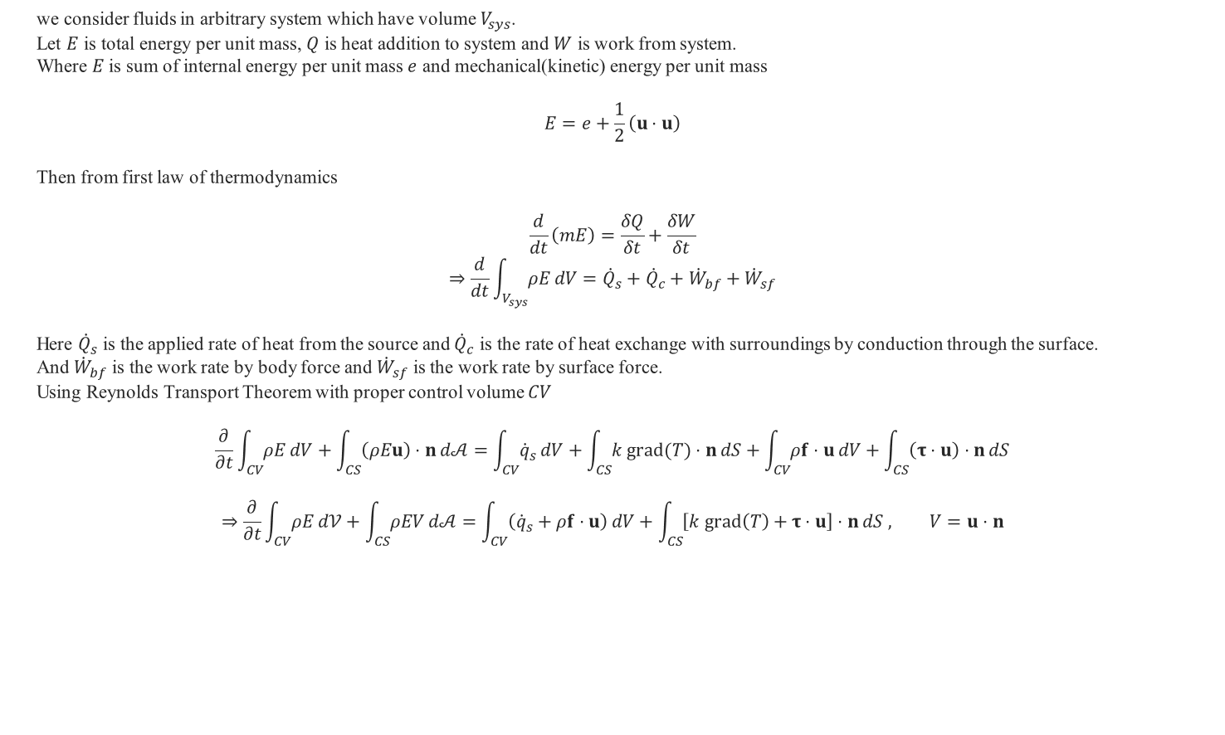
Conservation of Energy
we consider fluids in arbitrary system which have volume $V_{sys}$.
Let $E$ is total energy per unit mass, $Q$ is heat addition to system and $W$ is work from system.
Where $E$ is sum of internal energy per unit mass $e$ and mechanical(kinetic) energy per unit mass
$$E=e+\frac{1}{2}\left(u⋅u\right)$$
Then from first law of thermodynamics
$$\frac{d}{dt}\left(mE\right)=\frac{δQ}{δt}+\frac{δW}{δt}$$
$$⇒\frac{d}{dt}\int_{V_{sys}}{ρE}dV={\dot{Q}}_{s}+{\dot{Q}}_{c}+{\dot{W}}_{bf}+{\dot{W}}_{sf}$$
Here ${\dot{Q}}_{s}$ is the applied rate of heat from the source and ${\dot{Q}}_{c}$ is the rate of heat exchange with surroundings by conduction through the surface.
And ${\dot{W}}_{bf}$ is the work rate by body force and ${\dot{W}}_{sf}$ is the work rate by surface force.
Using Reynolds Transport Theorem with proper control volume $CV$
$$\frac{∂}{∂t}\int_{CV}{ρE}dV+\int_{CS}{\left(ρEu\right)⋅n}d𝒜=\int_{CV}{{\dot{q}}_{s}}dV+\int_{CS}{k grad(T)⋅n}dS+\int_{CV}{ρf⋅u}dV+\int_{CS}{\left(τ⋅u\right)⋅n}dS$$
$$⇒\frac{∂}{∂t}\int_{CV}{ρE}d𝒱+\int_{CS}{ρEV}d𝒜=\int_{CV}{\left({\dot{q}}_{s}+ρf⋅u\right)}dV+\int_{CS}{\left[k grad\left(T\right)+τ⋅u\right]⋅n}dS , V=u⋅n$$

Slide 10

Conservation of Energy
If every integrand in surface integral is differentiable, by divergence theorem
$$⇒\frac{∂}{∂t}\int_{CV}{ρE}d𝒱+\int_{CV}{div(ρEu)}d𝒱=\int_{CV}{\left({\dot{q}}_{s}+ρf⋅u\right)}d𝒱+\int_{CV}{div\left[k grad\left(T\right)+τ⋅u\right]}d𝒱$$
It should be always true in any volume, the only way is integrand of volume integral should be 0.
Thus differential form is derived
$$\frac{∂}{∂t}\left(ρE\right)+div(ρEu)=\left({\dot{q}}_{s}+ρf⋅u\right)+div\left[k grad\left(T\right)+τ⋅u\right]$$

Slide 11

Conservation Form of Governing Equation
Conservation form is form of systems of partial differential equation as follow
$$U_{t}+div\left(F\left(U\right)\right)=0$$
Where $U$ is called the vector of conserved variables and $F$ is called the flux tensor.
Now we consider a governing equation for fluids without body force.
$$\frac{∂ρ}{∂t}+div\left(ρu\right)=0$$
$$\frac{∂ρu}{∂t}+div\left(ρu⊗u\right)=div\left(τ\right)$$
$$\frac{∂ρE}{∂t}+div\left(ρEu\right)=div\left(τ⋅u\right)−div\left(q\right)$$
Rewrite the governing equation in the conservation form
$$U=\left\{\begin{aligned}ρ \\ ρu \\ ρv \\ ρw \\ ρE\end{aligned}\right\}$$
$$F(U)= \left[\begin{matrix}\begin{aligned}ρu \\ ρuu−τ_{11} \\ ρuv−τ_{12} \\ ρuw−τ_{13} \\ ρEu−\left(uτ_{11}+vτ_{21}+wτ_{31}\right)+q_{x}\end{aligned} & \begin{aligned}ρv \\ ρvu−τ_{21} \\ ρvv−τ_{22} \\ ρvw−τ_{23} \\ ρEv−\left(uτ_{12}+vτ_{22}+wτ_{32}\right)+q_{y}\end{aligned} & \begin{aligned}ρw \\ ρwu−τ_{31} \\ ρwv−τ_{32} \\ ρww−τ_{33} \\ ρEw−\left(uτ_{13}+vτ_{23}+wτ_{33}\right)+q_{z}\end{aligned}\end{matrix}\right]$$
It is conservation form of Navier-Stokes equation.

Slide 12

Conservation Form of Governing Equation
If we neglect viscous effect and thermal conduction, we have conservation form Euler equations.
Also $F(U)$ be convective flux tensor $F_{c}(U)$.
It is related to the convective transport of quantities in the fluid.
$$F_{c}(U)= \left[\begin{matrix}\begin{aligned}ρu \\ ρuu+p \\ ρuv \\ ρuw \\ \left(ρE+p\right)u\end{aligned} & \begin{aligned}ρv \\ ρvu \\ ρvv+p \\ ρvw \\ \left(ρE+p\right)v\end{aligned} & \begin{aligned}ρw \\ ρwu \\ ρwv \\ ρww+p \\ \left(ρE+p\right)w\end{aligned}\end{matrix}\right]$$
Left overs is viscous flux tensor $F_{v}(U)$ which is related to viscous stresses as well as the heat diffusion.
$$F_{v}\left(U\right)=F\left(U\right)−F_{c}\left(U\right)=\left\{\begin{matrix}\begin{matrix}0 \\ 0 \\ 0\end{matrix} & \begin{matrix}−(τ_{11}+p) & −τ_{12} & −τ_{13} \\ −τ_{21} & −(τ_{22}+p) & −τ_{23} \\ −τ_{31} & −τ_{32} & −(τ_{33}+p)\end{matrix} & \begin{matrix}−\left(uτ_{11}+vτ_{21}+wτ_{31}+p\right)+q_{x} \\ −\left(uτ_{12}+vτ_{22}+wτ_{32}+p\right)+q_{y} \\ −\left(uτ_{13}+vτ_{23}+wτ_{33}+p\right)+q_{z}\end{matrix}\end{matrix}\right\}$$

Slide 13
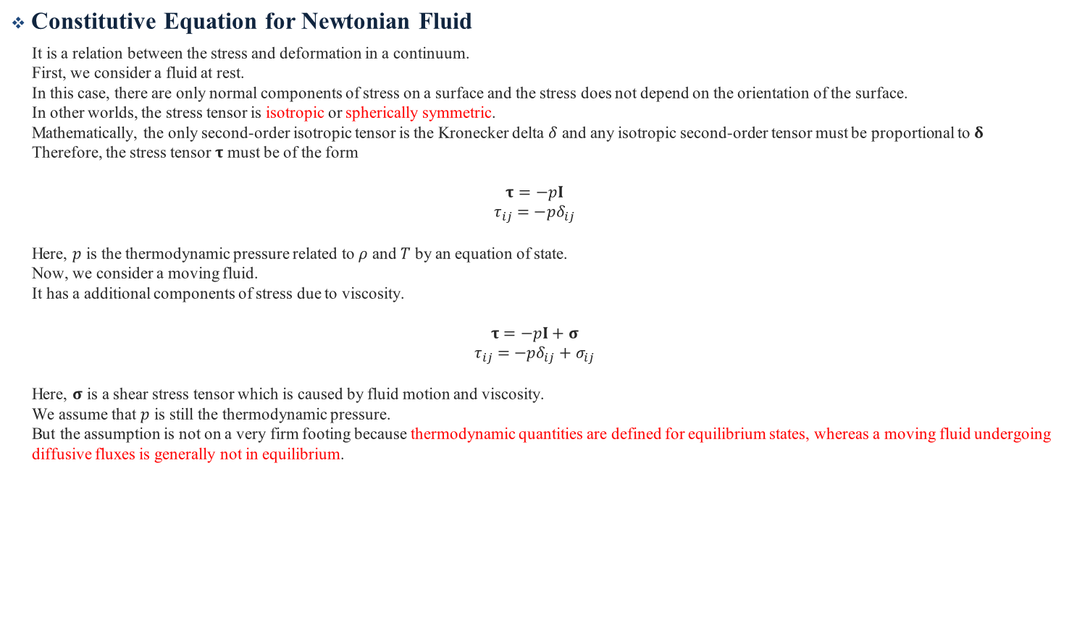
Appendix 1 Constitutive Equation for Newtonian Fluid
Constitutive Equation for Newtonian Fluid
It is a relation between the stress and deformation in a continuum.
First, we consider a fluid at rest.
In this case, there are only normal components of stress on a surface and the stress does not depend on the orientation of the surface.
In other worlds, the stress tensor is isotropic or spherically symmetric.
Mathematically, the only second-order isotropic tensor is the Kronecker delta $δ$ and any isotropic second-order tensor must be proportional to $δ$
Therefore, the stress tensor $τ$ must be of the form
$$τ=−pI$$
$$τ_{ij}=−pδ_{ij}$$
Here, $p$ is the thermodynamic pressure related to $ρ$ and $T$ by an equation of state.
Now, we consider a moving fluid.
It has a additional components of stress due to viscosity.
$$τ=−pI+σ$$
$$τ_{ij}=−pδ_{ij}+σ_{ij}$$
Here, $σ$ is a shear stress tensor which is caused by fluid motion and viscosity.
We assume that $p$ is still the thermodynamic pressure.
But the assumption is not on a very firm footing because thermodynamic quantities are defined for equilibrium states, whereas a moving fluid undergoing diffusive fluxes is generally not in equilibrium.

Slide 14
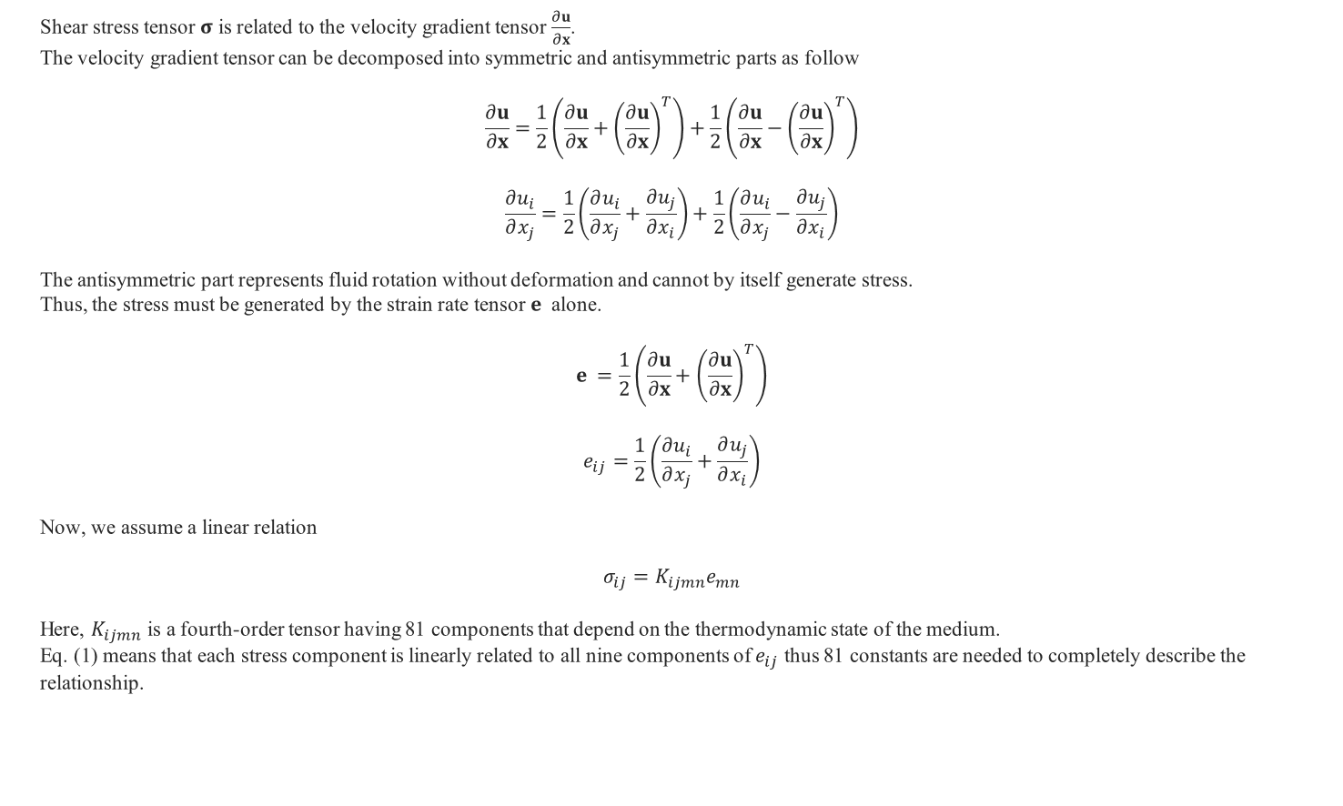
Appendix 1 Constitutive Equation for Newtonian Fluid
Shear stress tensor $σ$ is related to the velocity gradient tensor $\frac{∂u}{∂x}$.
The velocity gradient tensor can be decomposed into symmetric and antisymmetric parts as follow
$$\frac{∂u}{∂x}=\frac{1}{2}\left(\frac{∂u}{∂x}+{\left(\frac{∂u}{∂x}\right)}^{T}\right)+\frac{1}{2}\left(\frac{∂u}{∂x}−{\left(\frac{∂u}{∂x}\right)}^{T}\right)$$
$$\frac{∂u_{i}}{∂x_{j}}=\frac{1}{2}\left(\frac{∂u_{i}}{∂x_{j}}+\frac{∂u_{j}}{∂x_{i}}\right)+\frac{1}{2}\left(\frac{∂u_{i}}{∂x_{j}}−\frac{∂u_{j}}{∂x_{i}}\right)$$
The antisymmetric part represents fluid rotation without deformation and cannot by itself generate stress.
Thus, the stress must be generated by the strain rate tensor $e_{ }$ alone.
$$e_{ }=\frac{1}{2}\left(\frac{∂u}{∂x}+{\left(\frac{∂u}{∂x}\right)}^{T}\right)$$
$$e_{ij}=\frac{1}{2}\left(\frac{∂u_{i}}{∂x_{j}}+\frac{∂u_{j}}{∂x_{i}}\right)$$
Now, we assume a linear relation
$$σ_{ij}=K_{ijmn}e_{mn}$$
Here, $K_{ijmn}$ is a fourth-order tensor having 81 components that depend on the thermodynamic state of the medium.
Eq. (1) means that each stress component is linearly related to all nine components of $e_{ij}$ thus 81 constants are needed to completely describe the relationship.
(1)

Slide 15
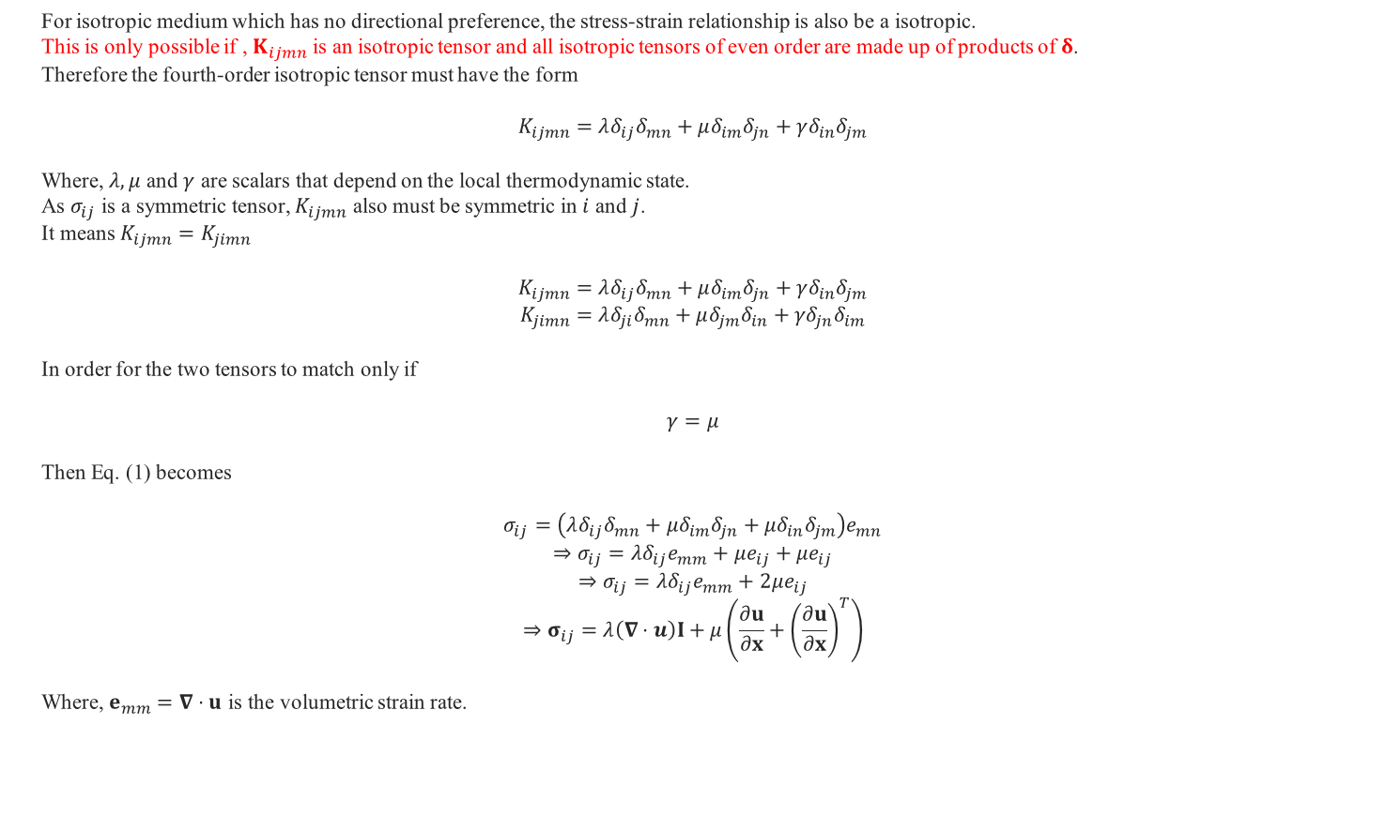
Appendix 1 Constitutive Equation for Newtonian Fluid
For isotropic medium which has no directional preference, the stress-strain relationship is also be a isotropic.
This is only possible if , $K_{ijmn}$ is an isotropic tensor and all isotropic tensors of even order are made up of products of $δ$.
Therefore the fourth-order isotropic tensor must have the form
$$K_{ijmn}=λδ_{ij}δ_{mn}+μδ_{im}δ_{jn}+γδ_{in}δ_{jm}$$
Where, $λ,μ$ and $γ$ are scalars that depend on the local thermodynamic state.
As $σ_{ij}$ is a symmetric tensor, $K_{ijmn}$ also must be symmetric in $i$ and $j$.
It means $K_{ijmn}=K_{jimn}$
$$K_{ijmn}=λδ_{ij}δ_{mn}+μδ_{im}δ_{jn}+γδ_{in}δ_{jm}$$
$$K_{jimn}=λδ_{ji}δ_{mn}+μδ_{jm}δ_{in}+γδ_{jn}δ_{im}$$
In order for the two tensors to match only if
$$γ=μ$$
Then Eq. (1) becomes
$$σ_{ij}=\left(λδ_{ij}δ_{mn}+μδ_{im}δ_{jn}+μδ_{in}δ_{jm}\right)e_{mn}$$
$$⇒σ_{ij}=λδ_{ij}e_{mm}+μe_{ij}+μe_{ij}$$
$$⇒σ_{ij}=λδ_{ij}e_{mm}+2μe_{ij}$$
$$⇒σ_{ij}=λ\left(∇⋅u\right)I+μ\left(\frac{∂u}{∂x}+{\left(\frac{∂u}{∂x}\right)}^{T}\right)$$
Where, $e_{mm}=∇⋅u$ is the volumetric strain rate.
(2)

Slide 16

Appendix 1 Constitutive Equation for Newtonian Fluid
The complete stress tensor $τ$ becomes
$$τ=−pI+λ (∇⋅u)I+μ\left(\frac{∂u}{∂x}+{\left(\frac{∂u}{∂x}\right)}^{T}\right)$$
We consider a diagonal term
$$τ_{ii}=−3p+3λ(∇⋅u) +2μ(∇⋅u)$$
$$⇒τ_{ii}=−3p+\left(3λ+2μ\right)(∇⋅u)$$
Since$(∇⋅u)$ may be unequal, the stress tensor $τ_{ii}$ can have unequal diagonal terms.
We can therefore take the average of $τ_{ii}$ and define a mean pressure $\overline{p}$
$$\overline{p}≡−\frac{1}{3}τ_{ii}$$
Substitute into Eq. (3) and look over the relationship between $\overline{p}$ and $p$
$$\overline{p}=p−\left(λ+\frac{2}{3}μ\right)(∇⋅u)$$
It shows the difference between $p$ and $\overline{p}$ to the rate of expansion through the proportionality constant $κ≡λ+\frac{2}{3}μ$ which is called the coefficients of bulk viscosity.

Slide 17
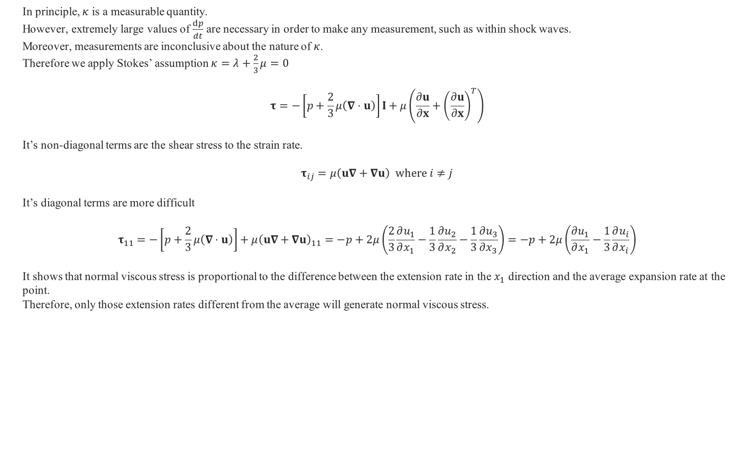
Appendix 1 Constitutive Equation for Newtonian Fluid
In principle, $κ$ is a measurable quantity.
However, extremely large values of $\frac{dp}{dt}$ are necessary in order to make any measurement, such as within shock waves.
Moreover, measurements are inconclusive about the nature of $κ$.
Therefore we apply Stokes’ assumption $κ=λ+\frac{2}{3}μ=0$
$$τ=−\left[p+\frac{2}{3}μ\left(∇⋅u\right)\right]I+μ\left(\frac{∂u}{∂x}+{\left(\frac{∂u}{∂x}\right)}^{T}\right)$$
It’s non-diagonal terms are the shear stress to the strain rate.
$$τ_{ij}=μ\left(u∇+∇u\right) where i≠j$$
It’s diagonal terms are more difficult
$$τ_{11}=−\left[p+\frac{2}{3}μ\left(∇⋅u\right)\right]+μ{\left(u∇+∇u\right)}_{11}=−p+2μ\left(\frac{2}{3}\frac{∂u_{1}}{∂x_{1}}−\frac{1}{3}\frac{∂u_{2}}{∂x_{2}}−\frac{1}{3}\frac{∂u_{3}}{∂x_{3}}\right)=−p+2μ\left(\frac{∂u_{1}}{∂x_{1}}−\frac{1}{3}\frac{∂u_{i}}{∂x_{i}}\right)$$
It shows that normal viscous stress is proportional to the difference between the extension rate in the $x_{1}$ direction and the average expansion rate at the point.
Therefore, only those extension rates different from the average will generate normal viscous stress.
(3)

Slide 18

Appendix 1 Constitutive Equation for Newtonian Fluid
In completely incompressible fluid where $∇⋅u=0$
$$\overline{p}=p$$
This result is coincide with the fact that thermodynamic pressure can’t be determined in incompressible fluid (Appendix 2).
Thus, $p$ can only be interpreted as the mean pressure.
Also $τ$ take simple form
$$τ=−pI+μ\left(\frac{∂u}{∂x}+{\left(\frac{∂u}{∂x}\right)}^{T}\right)$$
In inviscid fluid where $μ=0$
$τ$ take simple form
$$τ=−pI$$
Here, $p$ can be interpreted as thermodynamic pressure.

Slide 19

Appendix 2 Thermodynamic Pressure
First law of thermodynamics says
$$dU=Q−W$$
Here, $U$ denotes internal energy of a closed system , $Q$ denotes the quantity of energy supplied to the system as heat and $W$ denotes the amount of thermodynamic work done by the system on its surroundings.
When a system expands in a fictive quasi-static process, $W$ can be represented by mean pressure $P$ and volume change $dV$
$$dU=Q−PdV$$
If heat is supplied by reversible process
$$dU=TdS−PdV$$
In isentropic process
$$P=−\frac{dU}{dV}$$
For incompressible fluids, $dV=0$.
Thus $P$ can’t be determined.

